Slide 1
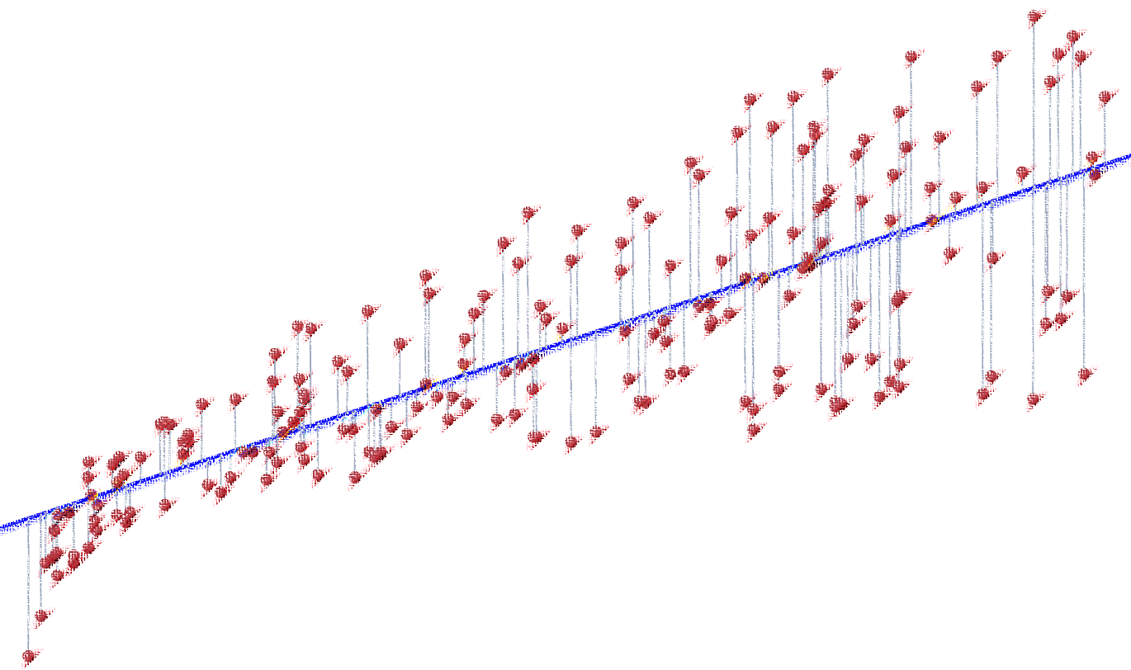

Lecture 2: Linear Regression
CSE445 Machine Learning
Jilan Samiuddin
Assistant Professor
North South University

Slide 2
Introduction
Linear Regression is a supervised machine learning algorithm used to model the relationship between one or more input features (independent variables) and a continuous output variable (dependent variable).
It works by learning from labeled data and fitting the best possible straight line – known as the line of best fit – through the data points.
The core assumption in linear regression is that there is a linear relationship between the input and output, i.e., the output variable changes at a constant rate with respect to the input.
Example: Predicting a person’s salary based on years of experience. As experience increases, the salary tends to increase in a linear manner.
Linear regression is widely used in applications like trend forecasting, risk assessment, and cost estimation due to its simplicity and interpretability.

Slide 3
Why Linear Regression?
Simplicity and Interpretability
Very intuitive and its mathematical foundation is straightforward, making it ideal for beginners and easy to explain
Predictive Power
It enables forecasting of future values based on historical data
Foundation for Advanced Models
Many complex models, like logistic regression, generalized linear models, and even neural networks, are built on the core principles of linear regression
Computational Efficiency
Fast to train and test, especially on small to medium-sized datasets with linear relationships, making it suitable for real-time and resource-constrained applications
Insight into Variable Relationships
It helps uncover how input variables influence the output

Slide 4
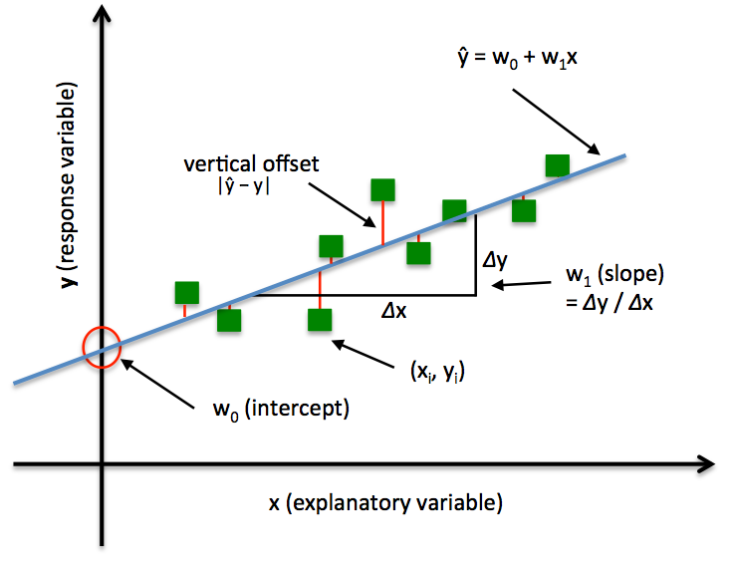
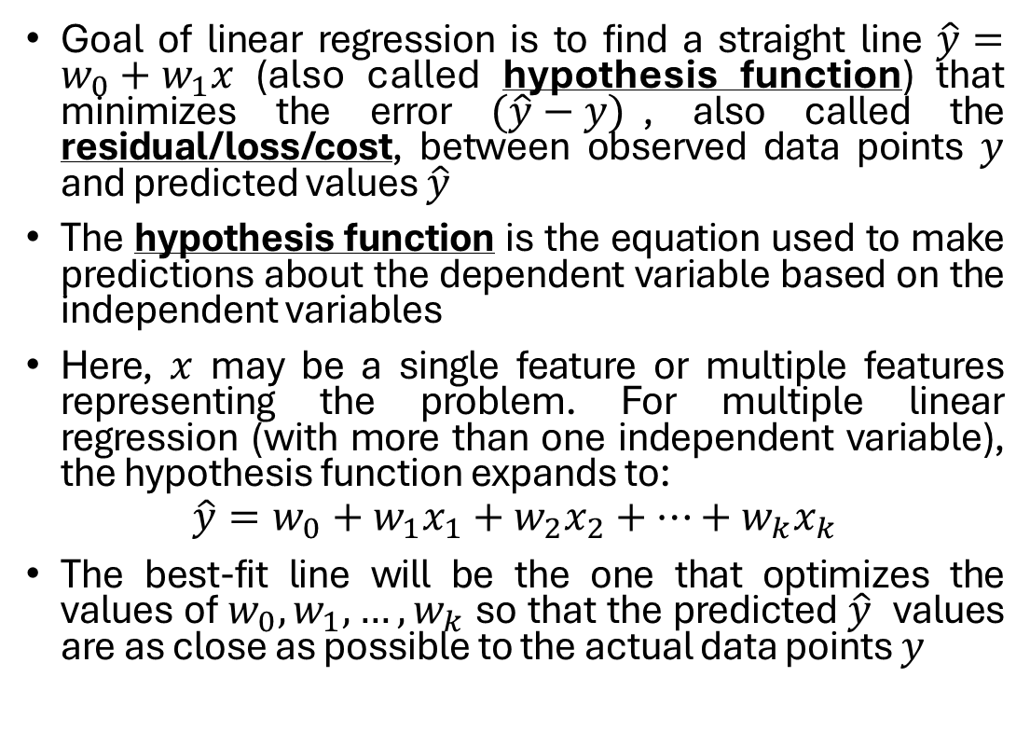
Simple Linear Regression
Goal of linear regression is to find a straight line $\hat{y}=w_{0}+w_{1}x$ (also called hypothesis function) that minimizes the error $(\hat{y}−y)$, also called the residual/loss/cost, between observed data points $y$ and predicted values $\hat{y}$
The hypothesis function is the equation used to make predictions about the dependent variable based on the independent variables
Here, $x$ may be a single feature or multiple features representing the problem. For multiple linear regression (with more than one independent variable), the hypothesis function expands to:
$$\hat{y}=w_{0}+w_{1}x_{1}+w_{2}x_{2}+…+w_{k}x_{k}$$
The best-fit line will be the one that optimizes the values of $w_{0}, w_{1},…,w_{k}$ so that the predicted $\hat{y}$ values are as close as possible to the actual data points $y$
Image source: MLXTEND (Github)

Slide 5
Few Assumptions on Linear Regression
Straight-Line Relationship (Linearity): The model assumes that the connection between the input (X) and the output (Y) is like a straight line. If you plot them on a graph, they should follow a clear trend.
Errors Do Not Influence Each Other (Independence of Errors): The mistakes the model makes (errors" or "residuals") should be random and not connected – one mistake should not cause another.
Errors Look Like a Bell Curve (Normality of Errors): The errors should follow a normal distribution, meaning most of them are small, and big errors are rare. This helps with accurate predictions and reliable confidence intervals.

Slide 6
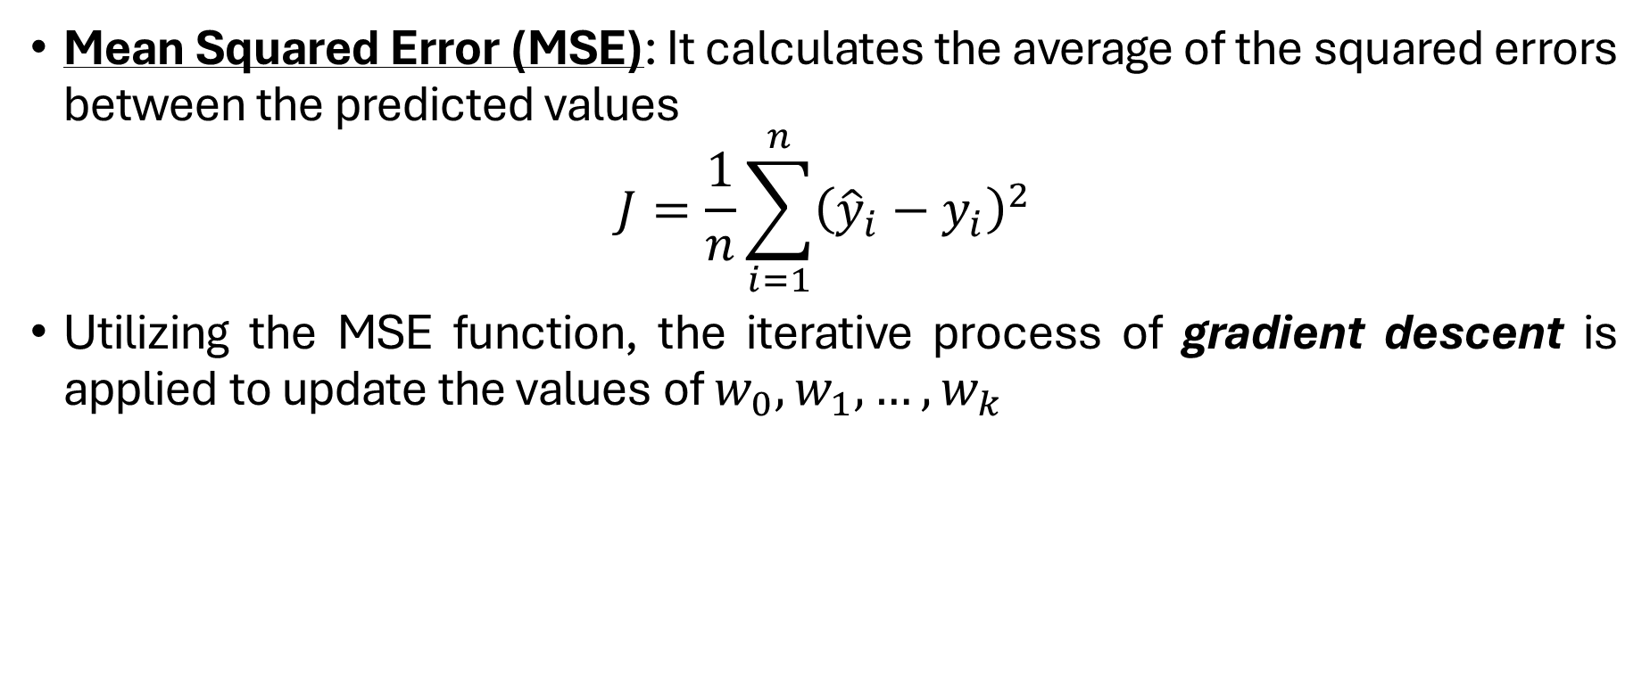
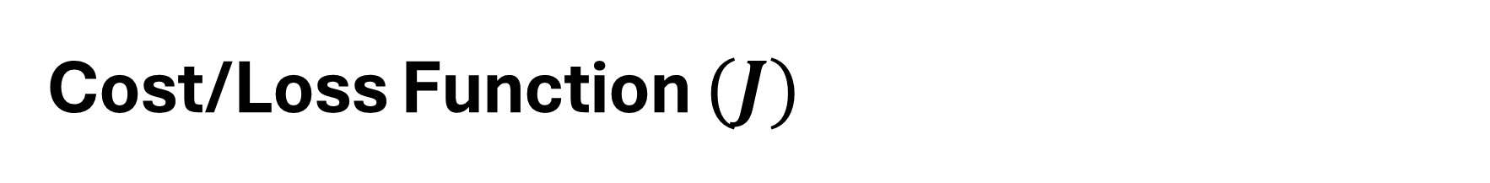
Cost/Loss Function $(J)$
Mean Squared Error (MSE): It calculates the average of the squared errors between the predicted values
$$J=\frac{1}{n}\sum_{i=1}^{n}{{\left({\hat{y}}_{i}−y_{i}\right)}^{2}}$$
Utilizing the MSE function, the iterative process of gradient descent is applied to update the values of $w_{0},w_{1},…,w_{k}$

Slide 7
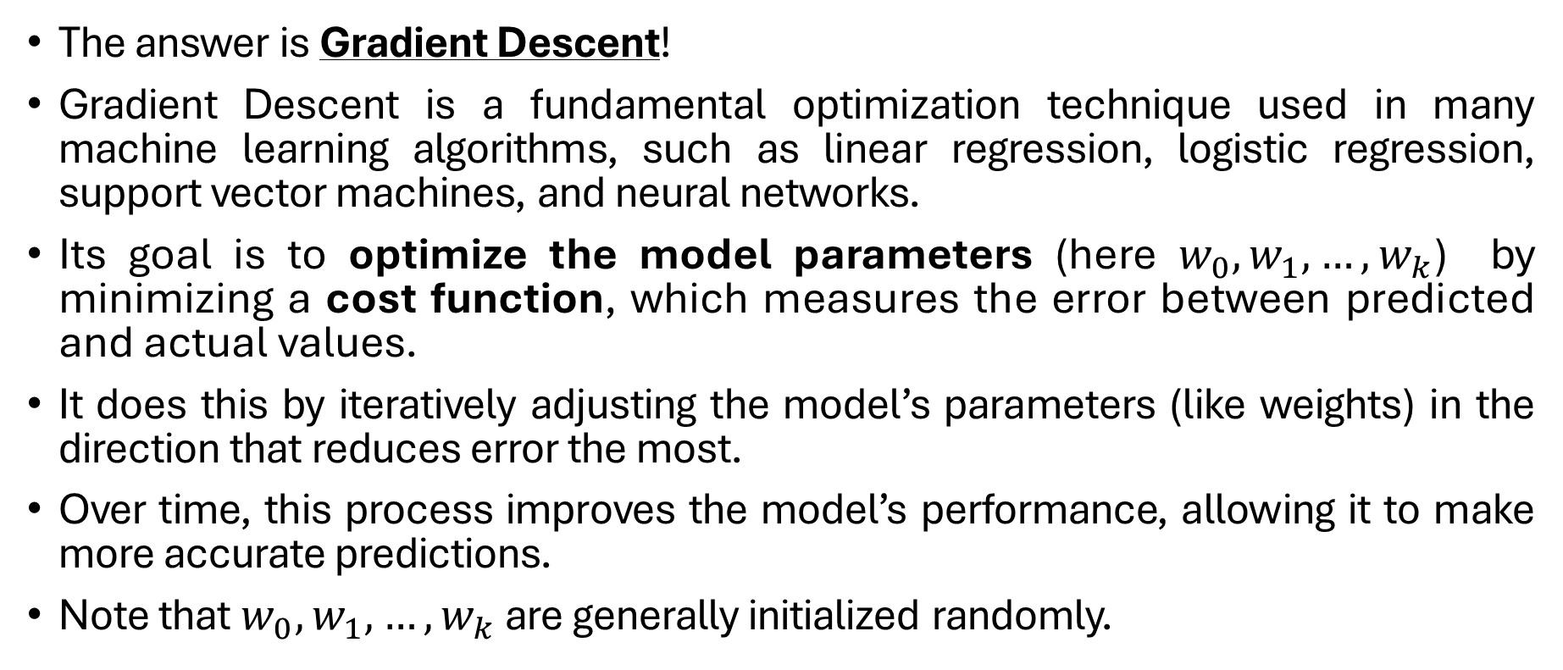

How do we find $w_{0}, w_{1},…,w_{k}$?
The answer is Gradient Descent!
Gradient Descent is a fundamental optimization technique used in many machine learning algorithms, such as linear regression, logistic regression, support vector machines, and neural networks.
Its goal is to optimize the model parameters (here $w_{0}, w_{1},…,w_{k}$) by minimizing a cost function, which measures the error between predicted and actual values.
It does this by iteratively adjusting the model’s parameters (like weights) in the direction that reduces error the most.
Over time, this process improves the model’s performance, allowing it to make more accurate predictions.
Note that $w_{0}, w_{1},…,w_{k}$ are generally initialized randomly.

Slide 8

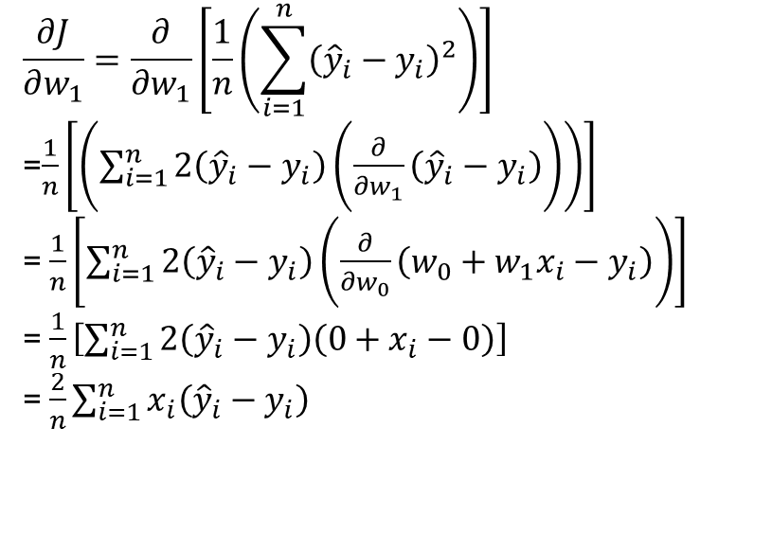
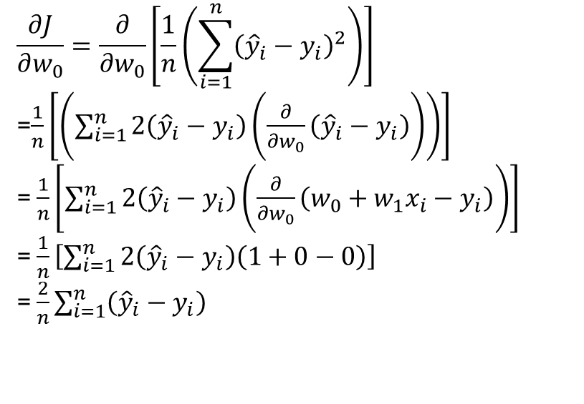
Gradient Descent in Linear Regression
Let us apply gradient descent for a single variable function $\hat{y}=w_{0}+w_{1}x$ for simplicity of understanding
First, differentiate the cost function ($J$) with respect to $w_{0}$ and $w_{1}$:
$$\frac{∂J}{∂w_{0}}=\frac{∂}{∂w_{0}}\left[\frac{1}{n}\left(\sum_{i=1}^{n}{{\left({\hat{y}}_{i}−y_{i}\right)}^{2}}\right)\right]$$
=$\frac{1}{n}\left[\left(\sum_{i=1}^{n}{2\left({\hat{y}}_{i}−y_{i}\right)\left(\frac{∂}{∂w_{0}}\left({\hat{y}}_{i}−y_{i}\right)\right)}\right)\right]$
= $\frac{1}{n}\left[\sum_{i=1}^{n}{2\left({\hat{y}}_{i}−y_{i}\right)\left(\frac{∂}{∂w_{0}}\left(w_{0}+w_{1}x_{i}−y_{i}\right)\right)}\right]$
= $\frac{1}{n}\left[\sum_{i=1}^{n}{2\left({\hat{y}}_{i}−y_{i}\right)\left(1+0−0\right)}\right]$
= $\frac{2}{n}\sum_{i=1}^{n}{\left({\hat{y}}_{i}−y_{i}\right)}$
$$\frac{∂J}{∂w_{1}}=\frac{∂}{∂w_{1}}\left[\frac{1}{n}\left(\sum_{i=1}^{n}{{\left({\hat{y}}_{i}−y_{i}\right)}^{2}}\right)\right]$$
=$\frac{1}{n}\left[\left(\sum_{i=1}^{n}{2\left({\hat{y}}_{i}−y_{i}\right)\left(\frac{∂}{∂w_{1}}\left({\hat{y}}_{i}−y_{i}\right)\right)}\right)\right]$
= $\frac{1}{n}\left[\sum_{i=1}^{n}{2\left({\hat{y}}_{i}−y_{i}\right)\left(\frac{∂}{∂w_{0}}\left(w_{0}+w_{1}x_{i}−y_{i}\right)\right)}\right]$
= $\frac{1}{n}\left[\sum_{i=1}^{n}{2\left({\hat{y}}_{i}−y_{i}\right)\left(0+x_{i}−0\right)}\right]$
= $\frac{2}{n}\sum_{i=1}^{n}{x_{i}\left({\hat{y}}_{i}−y_{i}\right)}$

Slide 9
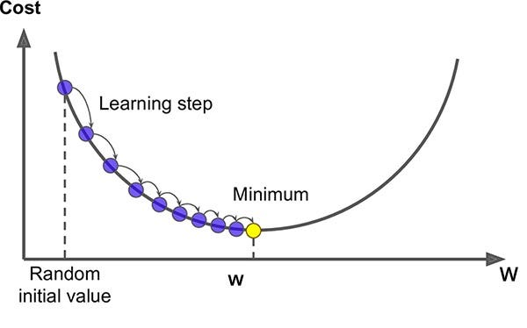
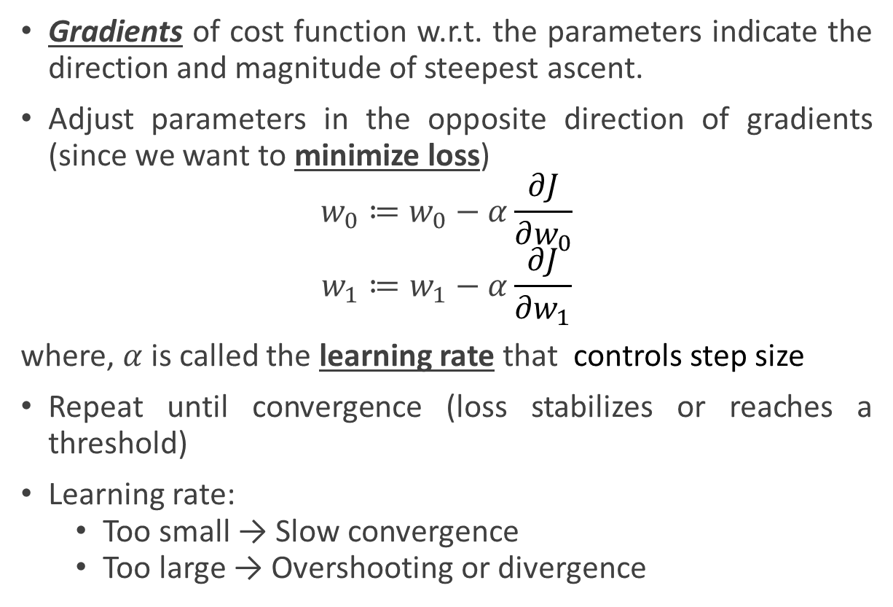


Gradient Descent (contd.)
Gradients of cost function w.r.t. the parameters indicate the direction and magnitude of steepest ascent.
Adjust parameters in the opposite direction of gradients (since we want to minimize loss)
$$w_{0}≔w_{0}−α\frac{∂J}{∂w_{0}}$$
$$w_{1}≔w_{1}−α\frac{∂J}{∂w_{1}}$$
where, $α$ is called the learning rate that controls step size
Repeat until convergence (loss stabilizes or reaches a threshold)
Learning rate:
Too small → Slow convergence
Too large → Overshooting or divergence
$\frac{∂J}{∂w_{0}}$= $\frac{2}{n}\sum_{i=1}^{n}{\left({\hat{y}}_{i}−y_{i}\right)}$
$\frac{∂J}{∂w_{1}}=$ $\frac{2}{n}\sum_{i=1}^{n}{x_{i}\left({\hat{y}}_{i}−y_{i}\right)}$
Image source: Rishi Zirpe, GoPenAi

Slide 10
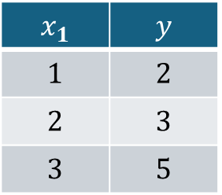
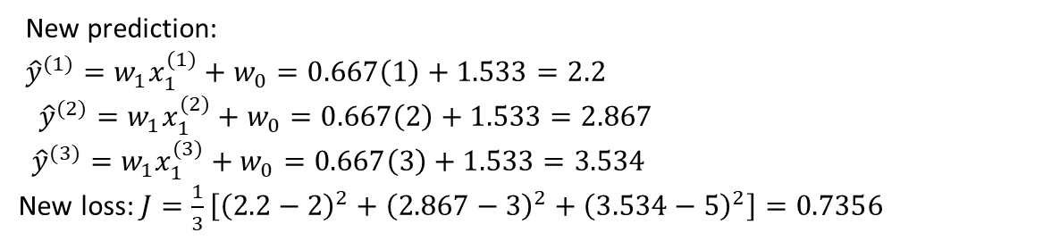
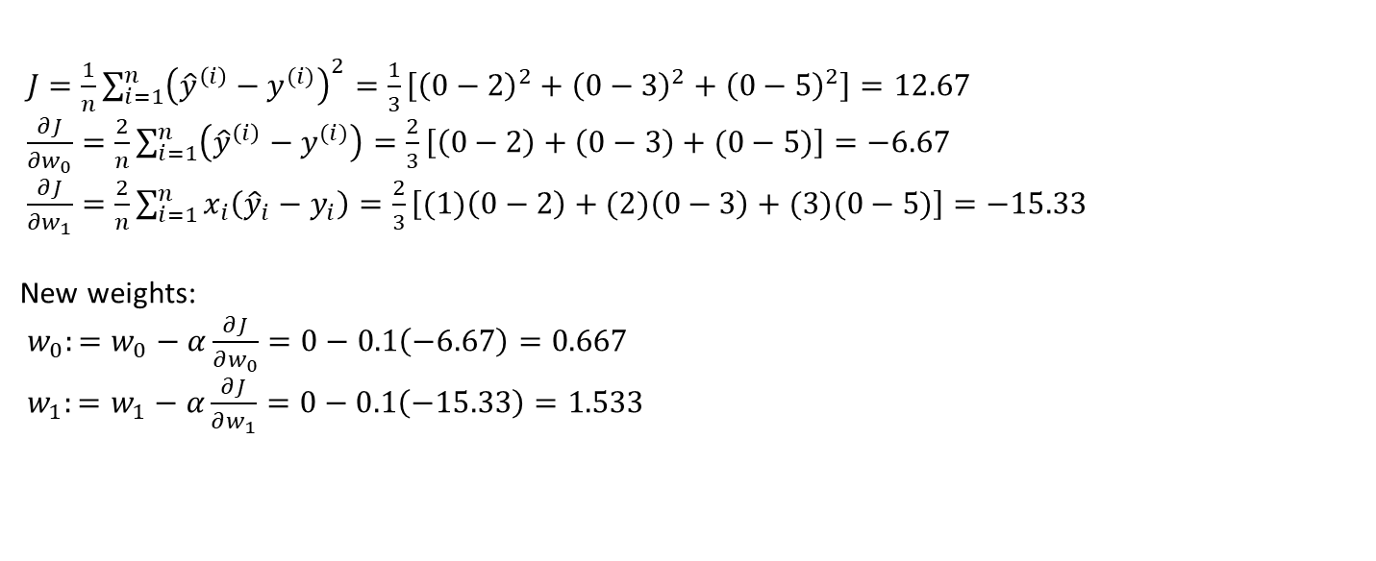
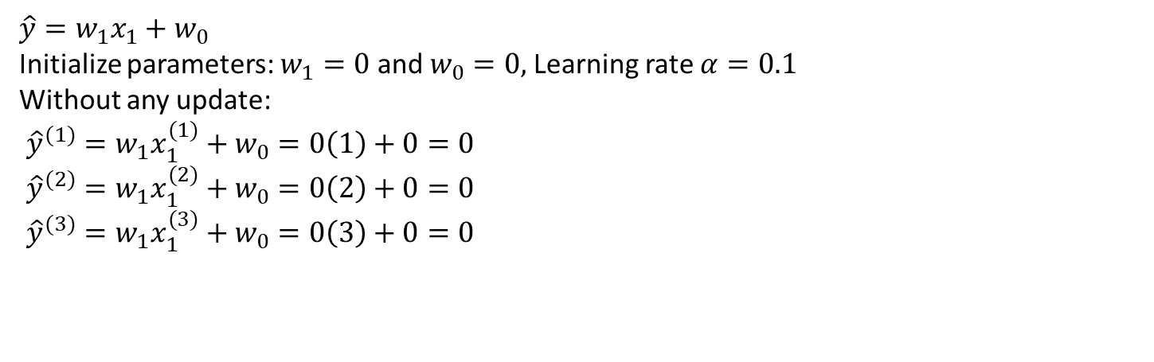
Mathematical Example
$$x_{1}$$ | $$y$$
$$1$$ | $$2$$
$$2$$ | $$3$$
$$3$$ | $$5$$
$$\hat{y}=w_{1}x_{1}+w_{0}$$
Initialize parameters: $w_{1}=0$ and $w_{0}=0,$ Learning rate $α=0.1$
Without any update:
${\hat{y}}^{(1)}=w_{1}x_{1}^{(1)}+w_{0}=0\left(1\right)+0=0$
${\hat{y}}^{(2)}=w_{1}x_{1}^{(2)}+w_{0}=0\left(2\right)+0=0$
${\hat{y}}^{(3)}=w_{1}x_{1}^{(3)}+w_{0}=0\left(3\right)+0=0$
$J=\frac{1}{n}\sum_{i=1}^{n}{{\left({\hat{y}}^{\left(i\right)}−y^{(i)}\right)}^{2}}=\frac{1}{3}\left[{\left(0−2\right)}^{2}+{\left(0−3\right)}^{2}+{\left(0−5\right)}^{2}\right]=12.67$
$\frac{∂J}{∂w_{0}}=\frac{2}{n}\sum_{i=1}^{n}{\left({\hat{y}}^{\left(i\right)}−y^{(i)}\right)}=\frac{2}{3}\left[\left(0−2\right)+\left(0−3\right)+(0−5)\right]=−6.67$
$\frac{∂J}{∂w_{1}}=\frac{2}{n}\sum_{i=1}^{n}{x_{i}\left({\hat{y}}_{i}−y_{i}\right)}=\frac{2}{3}\left[(1)\left(0−2\right)+(2)\left(0−3\right)+(3)(0−5)\right]=−15.33$
New weights:
$w_{0}:=w_{0}−α\frac{∂J}{∂w_{0}}=0−0.1\left(−6.67\right)=0.667$
$w_{1}:=w_{1}−α\frac{∂J}{∂w_{1}}=0−0.1\left(−15.33\right)=1.533$
Just after one single update,
The loss dropped significantly!
New prediction:
${\hat{y}}^{(1)}=w_{1}x_{1}^{(1)}+w_{0}=0.667\left(1\right)+1.533=2.2$
${\hat{y}}^{(2)}=w_{1}x_{1}^{(2)}+w_{0}=0.667\left(2\right)+1.533=2.867$
${\hat{y}}^{(3)}=w_{1}x_{1}^{(3)}+w_{0}=0.667\left(3\right)+1.533=3.534$
New loss: $J=\frac{1}{3}\left[{\left(2.2−2\right)}^{2}+{\left(2.867−3\right)}^{2}+{\left(3.534−5\right)}^{2}\right]=0.7356$

Slide 11
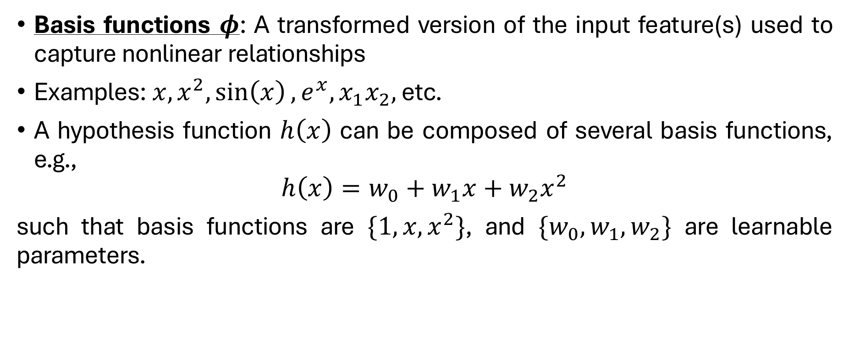
Linear Basis Models
Basis functions $φ$: A transformed version of the input feature(s) used to capture nonlinear relationships
Examples: $x, x^{2},\sin\left(x\right), e^{x}, x_{1}x_{2},$ etc.
A hypothesis function $h\left(x\right)$ can be composed of several basis functions, e.g.,
$$h\left(x\right)=w_{0}+w_{1}x+w_{2}x^{2}$$
such that basis functions are $\{1,x,x^{2}\}$, and ${\{w}_{0},w_{1},w_{2}\}$ are learnable parameters.

Slide 12
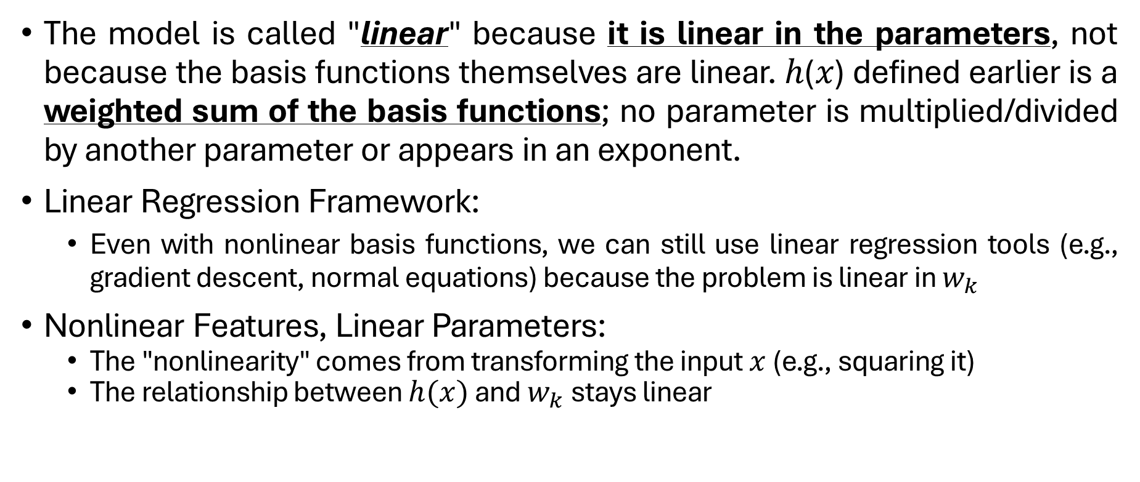
Linear Basis Models – How is it linear?
The model is called "linear" because it is linear in the parameters, not because the basis functions themselves are linear. ℎ(𝑥) defined earlier is a weighted sum of the basis functions; no parameter is multiplied/divided by another parameter or appears in an exponent.
Linear Regression Framework:
Even with nonlinear basis functions, we can still use linear regression tools (e.g., gradient descent, normal equations) because the problem is linear in $w_{k}$
Nonlinear Features, Linear Parameters:
The "nonlinearity" comes from transforming the input $x$ (e.g., squaring it)
The relationship between $h(x)$ and $w_{k}$ stays linear

Slide 13
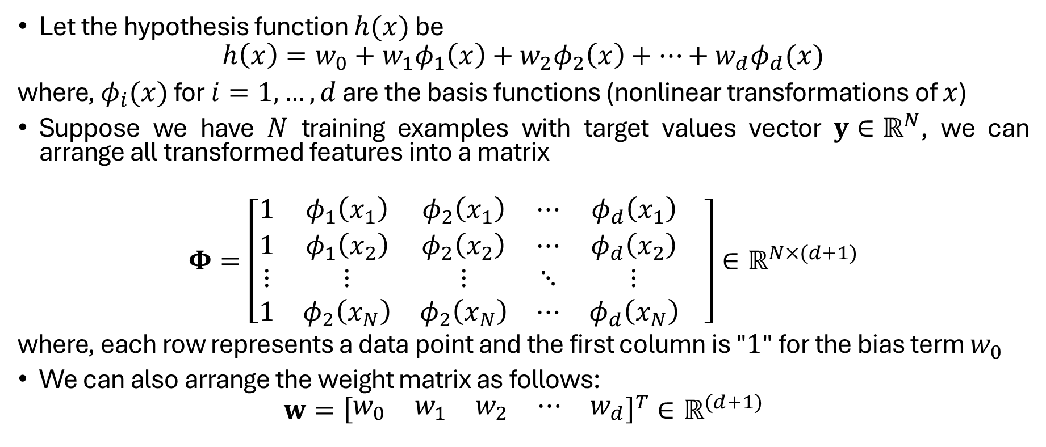
Linear Basis Models – Mathematical Framework
Let the hypothesis function $h(x)$ be
$$h\left(x\right)=w_{0}+w_{1}φ_{1}\left(x\right)+w_{2}φ_{2}\left(x\right)+…+w_{d}φ_{d}(x)$$
where, $φ_{i}(x)$ for $i=1,…,d$ are the basis functions (nonlinear transformations of $x$)
Suppose we have $N$ training examples with target values vector $y∈ℝ^{N}$, we can arrange all transformed features into a matrix
$$Φ=\left[\begin{matrix}1 & φ_{1}\left(x_{1}\right) & φ_{2}\left(x_{1}\right) & ⋯ & φ_{d}\left(x_{1}\right) \\ 1 & φ_{1}\left(x_{2}\right) & φ_{2}\left(x_{2}\right) & ⋯ & φ_{d}\left(x_{2}\right) \\ ⋮ & ⋮ & ⋮ & ⋱ & ⋮ \\ 1 & φ_{2}\left(x_{N}\right) & φ_{2}\left(x_{N}\right) & ⋯ & φ_{d}\left(x_{N}\right)\end{matrix} \right]∈ℝ^{N×(d+1)}$$
where, each row represents a data point and the first column is "$1$" for the bias term $w_{0}$
We can also arrange the weight matrix as follows:
$$w={\left[\begin{matrix}w_{0} & w_{1} & w_{2} & ⋯ & w_{d}\end{matrix}\right]}^{T}∈ℝ^{(d+1)}$$

Slide 14
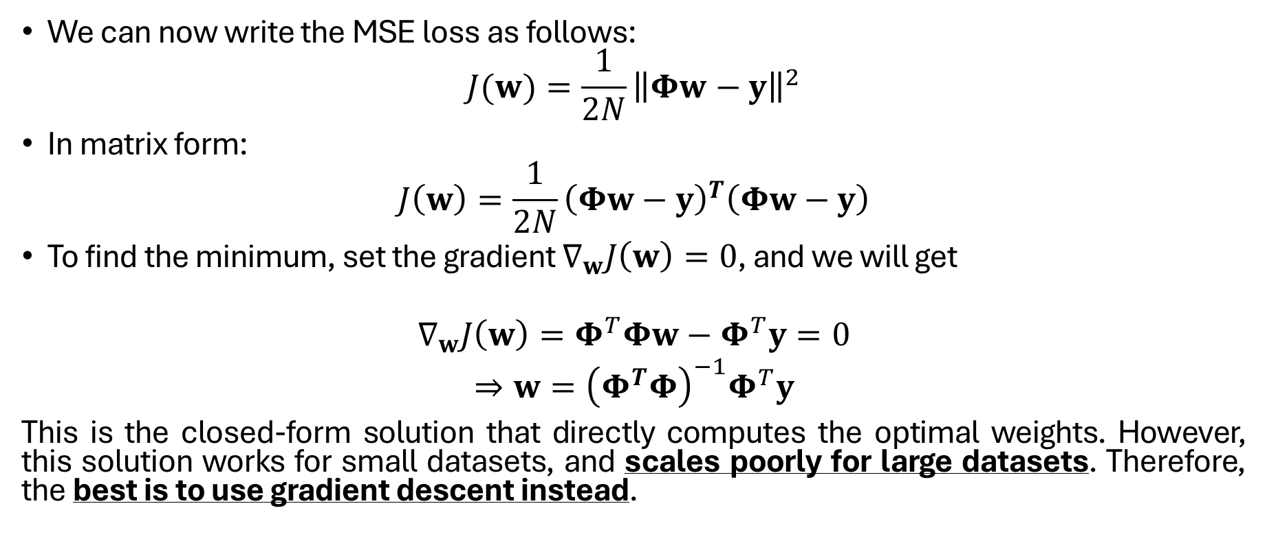
Mathematical Framework (contd.)
We can now write the MSE loss as follows:
$$J(w)=\frac{1}{2N}{\left\|Φw−y\right\|}^{2}$$
In matrix form:
$$J\left(w\right)=\frac{1}{2N}{\left(Φw−y\right)}^{T}\left(Φw−y\right)$$
To find the minimum, set the gradient $∇_{w}J\left(w\right)=0$, and we will get
$$∇_{w}J\left(w\right)=Φ^{T}Φw−Φ^{T}y=0$$
$⇒w={\left(Φ^{T}Φ\right)}^{−1}Φ^{T}y$
This is the closed-form solution that directly computes the optimal weights. However, this solution works for small datasets, and scales poorly for large datasets. Therefore, the best is to use gradient descent instead.

Slide 15
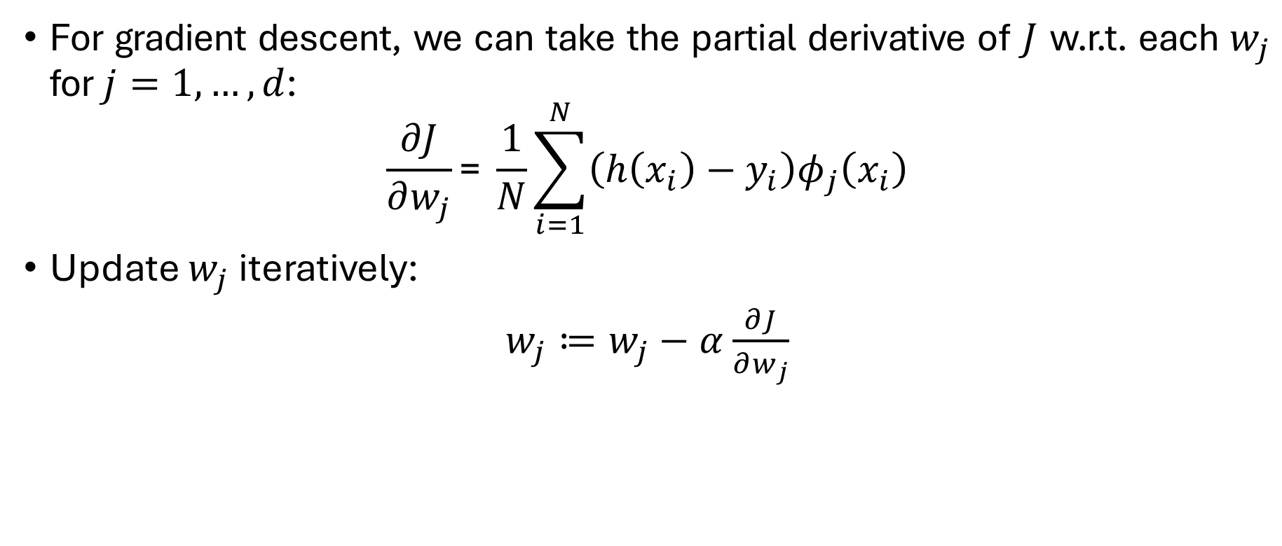
Mathematical Framework (contd.)
For gradient descent, we can take the partial derivative of $J$ w.r.t. each $w_{j}$ for $j=1,…,d$:
$$\frac{∂J}{∂w_{j}}\text{= }\frac{1}{N}\sum_{i=1}^{N}{\left(h\left(x_{i}\right)−y_{i}\right)φ_{j}\left(x_{i}\right)}$$
Update $w_{j}$ iteratively:
$w_{j}≔w_{j}−α$ $\frac{∂J}{∂w_{j}}$

Slide 16
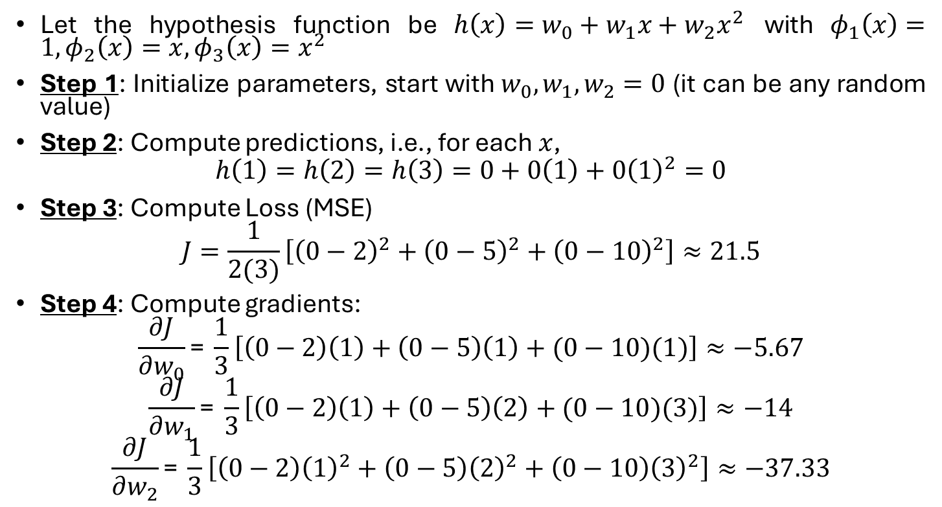
Example using gradient descent
Let the hypothesis function be $h\left(x\right)=w_{0}+w_{1}x+w_{2}x^{2}$ with $φ_{1}\left(x\right)=1,φ_{2}\left(x\right)=x,φ_{3}\left(x\right)=x^{2}$
Step 1: Initialize parameters, start with $w_{0},w_{1},w_{2}=0$ (it can be any random value)
Step 2: Compute predictions, i.e., for each $x$,
$$h\left(1\right)=h\left(2\right)=h\left(3\right)=0+0\left(1\right)+0{\left(1\right)}^{2}=0$$
Step 3: Compute Loss (MSE)
$$J=\frac{1}{2(3)}\left[{\left(0−2\right)}^{2}+{\left(0−5\right)}^{2}+{\left(0−10\right)}^{2}\right]≈21.5$$
Step 4: Compute gradients:
$$\frac{∂J}{∂w_{0}}\text{= }\frac{1}{3}\left[\left(0−2\right)\left(1\right)+\left(0−5\right)\left(1\right)+(0−10)(1)\right]≈−5.67$$
$$\frac{∂J}{∂w_{1}}\text{= }\frac{1}{3}\left[\left(0−2\right)\left(1\right)+\left(0−5\right)\left(2\right)+(0−10)(3)\right]≈−14$$
$$\frac{∂J}{∂w_{2}}\text{= }\frac{1}{3}\left[\left(0−2\right){\left(1\right)}^{2}+\left(0−5\right){\left(2\right)}^{2}+\left(0−10\right){\left(3\right)}^{2}\right]≈−37.33$$
x | y (target)
1 | 2
2 | 5
3 | 10

Slide 17
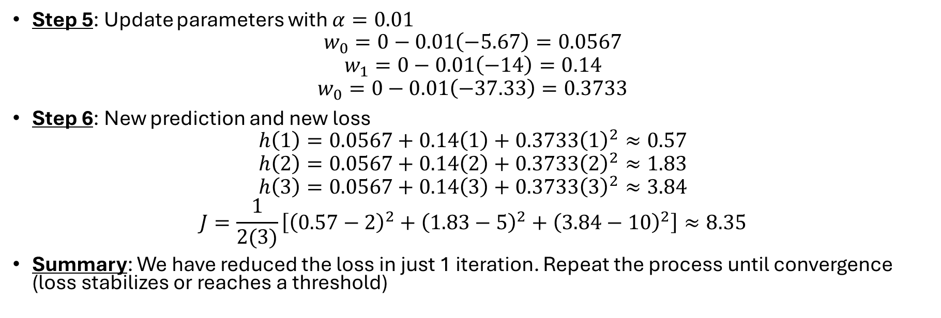
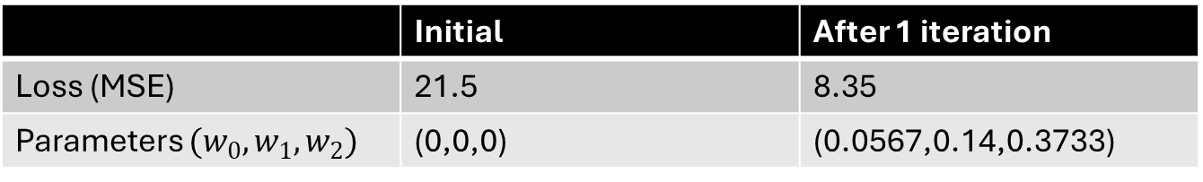
Example (contd.)
Step 5: Update parameters with $α=0.01$
$$w_{0}=0−0.01\left(−5.67\right)=0.0567$$
$$w_{1}=0−0.01\left(−14\right)=0.14$$
$$w_{0}=0−0.01\left(−37.33\right)=0.3733$$
Step 6: New prediction and new loss
$$h\left(1\right)=0.0567+0.14\left(1\right)+0.3733{\left(1\right)}^{2}≈0.57$$
$$h\left(2\right)=0.0567+0.14\left(2\right)+0.3733{\left(2\right)}^{2}≈1.83$$
$$h\left(3\right)=0.0567+0.14\left(3\right)+0.3733{\left(3\right)}^{2}≈3.84$$
$$J=\frac{1}{2(3)}\left[{\left(0.57−2\right)}^{2}+{\left(1.83−5\right)}^{2}+{\left(3.84−10\right)}^{2}\right]≈8.35$$
Summary: We have reduced the loss in just 1 iteration. Repeat the process until convergence (loss stabilizes or reaches a threshold)
 | Initial | After 1 iteration
Loss (MSE) | 21.5 | 8.35
Parameters $(w_{0},w_{1},w_{2})$ | (0,0,0) | (0.0567,0.14,0.3733)

Slide 18

Evaluation Metrics
A variety of evaluation measures can be used to determine the strength of any linear regression model. Here are three common ones:
Mean Square Error (MSE): Measures the average of the squared prediction errors, heavily penalizing large mistakes
Mean Absolute Error (MAE): Calculates the average absolute error, offering an interpretable “average miss” in the original units
$$MAE=\frac{1}{n}\sum_{i=1}^{n}{\left|{\hat{y}}_{i}−y_{i}\right|}$$
Root Mean Squared Error (RMSE): Simply the square root of MSE, bringing the scale of errors back to the original units while still penalizing big errors
$$RMSE=\sqrt{\frac{\sum_{i=1}^{n}{{\left({\hat{y}}_{i}−y_{i}\right)}^{2}}}{n}}$$
Coefficient of Determination (R²): Indicates the proportion of variance in the target explained by the model, ranging from 0 (no explanatory power) to 1 (perfect fit)
$$R^{2}=1−\frac{\text{residual} \text{sum} \text{of} \text{squares} \text{(}\text{RSS}\text{)}}{\text{total} \text{sum} \text{of} \text{squares}\text{ (}\text{TSS}\text{) }}=1−\frac{\sum_{i=1}^{n}{{\left({\hat{y}}_{i}−y_{i}\right)}^{2}}}{\sum_{i=1}^{n}{{\left(\overline{y}−y_{i}\right)}^{2}}}$$

Slide 19

Regularization
While evaluation metrics are used to measure how well a model performs, regularization helps to improve that performance by reducing overfitting and promoting better generalization to unseen data.
L1 (Lasso) Regularization:
$J=\frac{1}{2n}\sum_{i=1}^{n}{{\left({\hat{y}}_{i}−y_{i}\right)}^{2}}+λ\sum_{j=1}^{n}{|w_{j}|}$
Adds a penalty proportional to the absolute values of model coefficients ($w_{j}$)
Encourages sparsity by shrinking some coefficients to zero (feature selection)
L2 (Ridge) Regularization:
$$J=\frac{1}{2n}\sum_{i=1}^{n}{{\left({\hat{y}}_{i}−y_{i}\right)}^{2}}+λ\sum_{j=1}^{n}{{\left(w_{j}\right)}^{2}}$$
Adds a penalty proportional to the squared values of coefficients ($w_{j}$)
Shrinks coefficients uniformly but rarely zeros them out (prevents overfitting)
Elastic Net:
$J=\frac{1}{2n}\sum_{i=1}^{n}{{\left({\hat{y}}_{i}−y_{i}\right)}^{2}}+λ_{1}\sum_{j=1}^{n}{|w_{j}|}+λ_{2}\sum_{j=1}^{n}{{\left(w_{j}\right)}^{2}}$
Combines both L1 and L2 regularization techniques
Balances sparsity and shrinkage

Slide 20
Regularization – A Qualitative Example
Predicting house prices with 100+ features (e.g., room size, neighborhood metrics), where,
Highly related features (square footage, lot size, age of the house, etc.)
Some features are correlated (e.g., “square footage” and “number of bedrooms/bathrooms”).
Many features are irrelevant (e.g., listing number, color of the front door, etc.)
L1 helps select key features (e.g., “square footage”) by zeroing out coefficients
L2 controls model complexity, especially when features are correlated. It does not zero out coefficients – it just shrinks them unlike L1 (e.g., L2 regularization might shrink both coefficients of “square footage” and “number of bedrooms/bathrooms” rather than choosing one and discarding the other, which L1 tends to do)
Elastic Net combines the power of both L1 and L2

